Slide 1
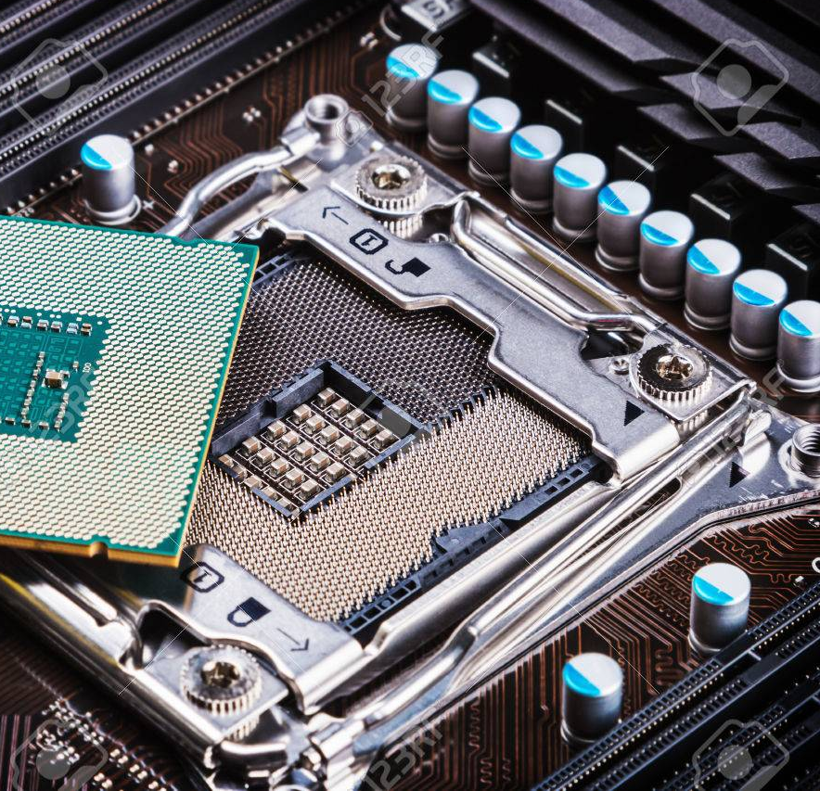
Hardware Components

Slide 2
The Motherboard
All these devices connect to a main circuit board called a motherboard

Slide 3
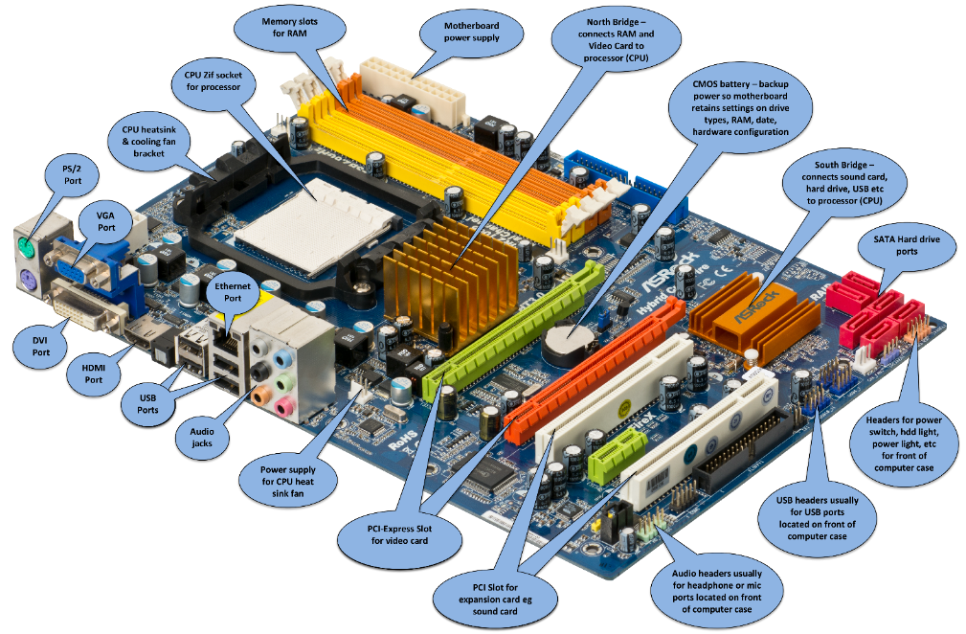

Slide 4
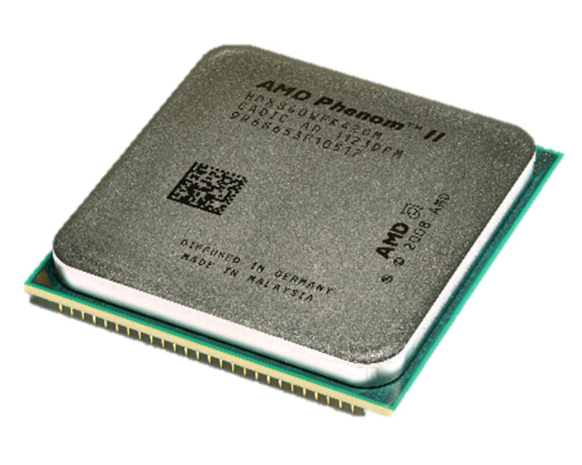
CPU
CPU performs all types of data processing operations
Fetches, decodes and executes instructions stored in RAM
Two lines of chips manufactured by Intel and AMD eg Core i5 and Ryzen 5.

Slide 5
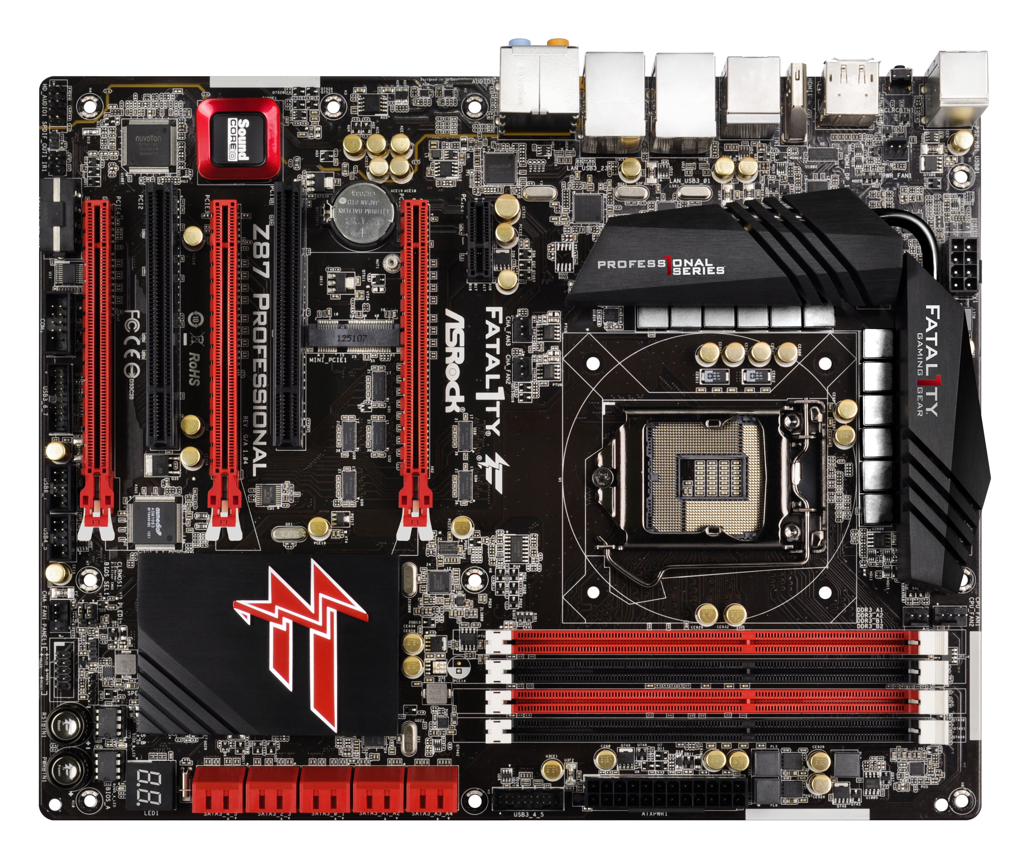

Slide 7
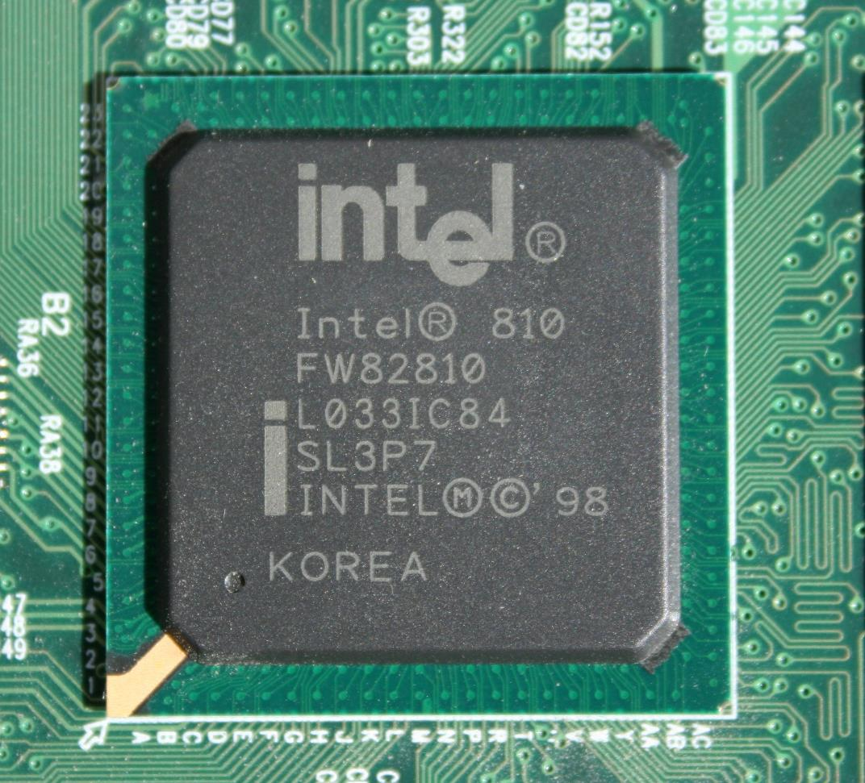
Chipset
Orchestrates the flow of data between key components of the computer
communication between the CPU, RAM, storage and other peripherals
Also controls external buses, memory cache and some peripherals. A CPU is unable to function without the chipset timing
Designed by Intel and AMD

Slide 8
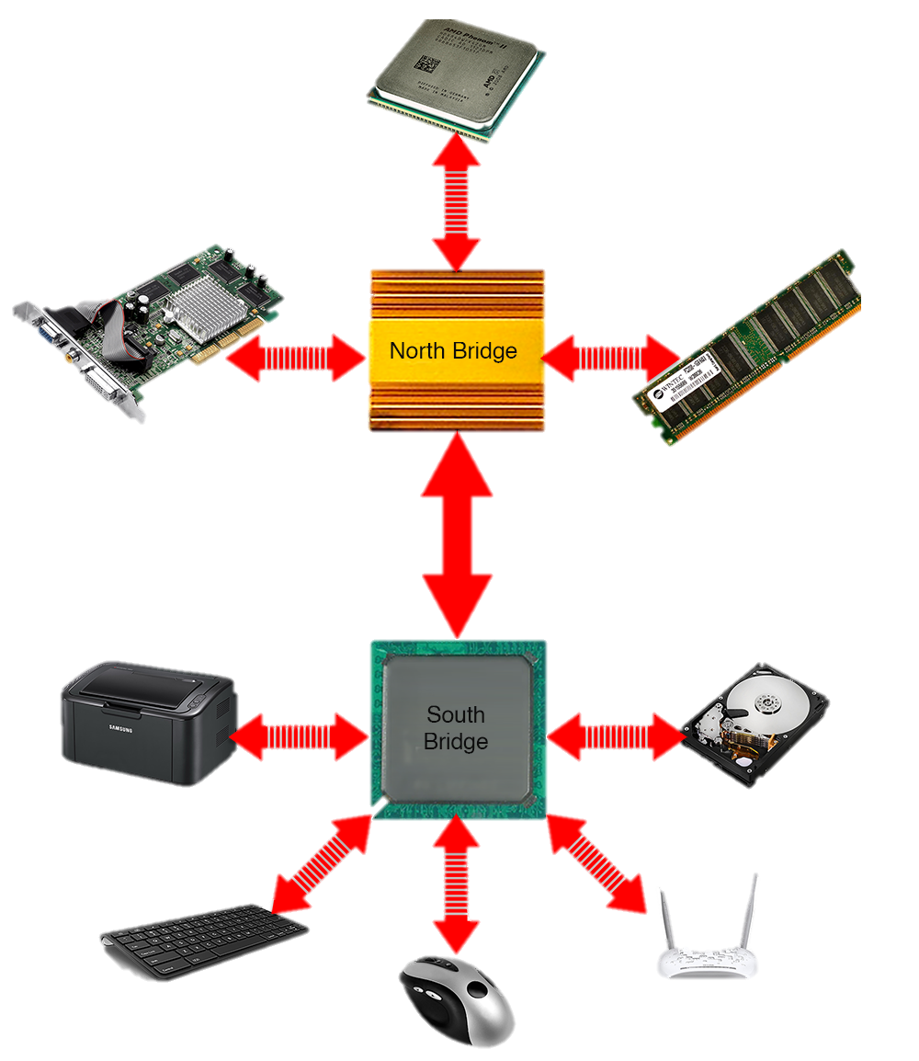
North Bridge
The northbridge is also known as a front side bus
A high-speed path between the CPU, RAM and video card

Slide 9
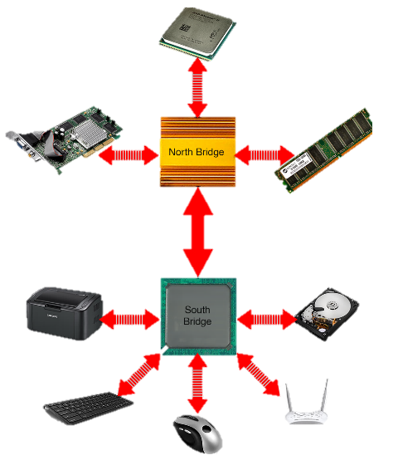
South Bridge
Communicates with all the slow hardware devices
SATA/ATA hard disk
USB

Slide 10
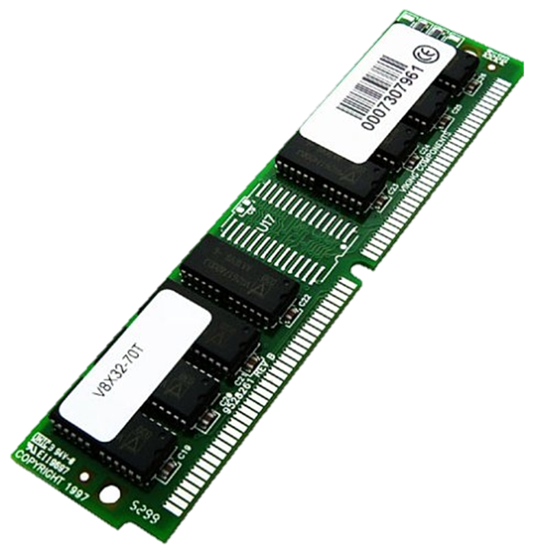
RAM
RAM is volatile, i.e. data stored in is lost when power is off
Two types
SRAM faster, doesn’t need to be refreshed
DRAM slower than SRAM and must be continually refreshed
Comes in SDRAM modules (DDR2, DDR3, DDR4 etc.

Slide 13
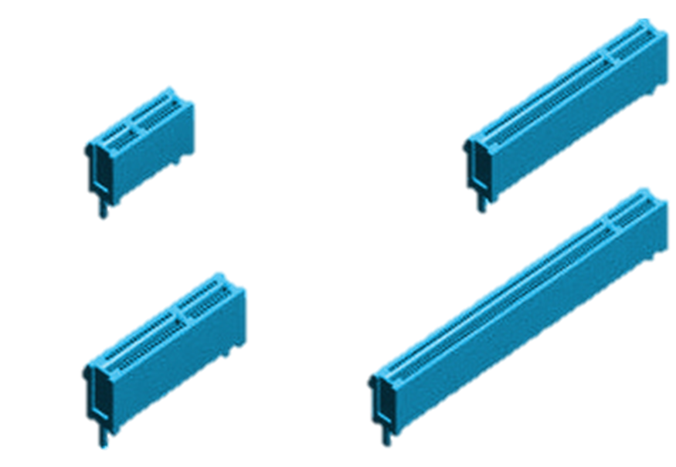
Expansion Slots
A place on the motherboard where expansion cards can be inserted.
PCIe – PCI Express
Various sizes (X1 – X16)
X1 slower for audio/network card
X16 is fast for graphics card
x1
x8
x4
x16

Slide 16
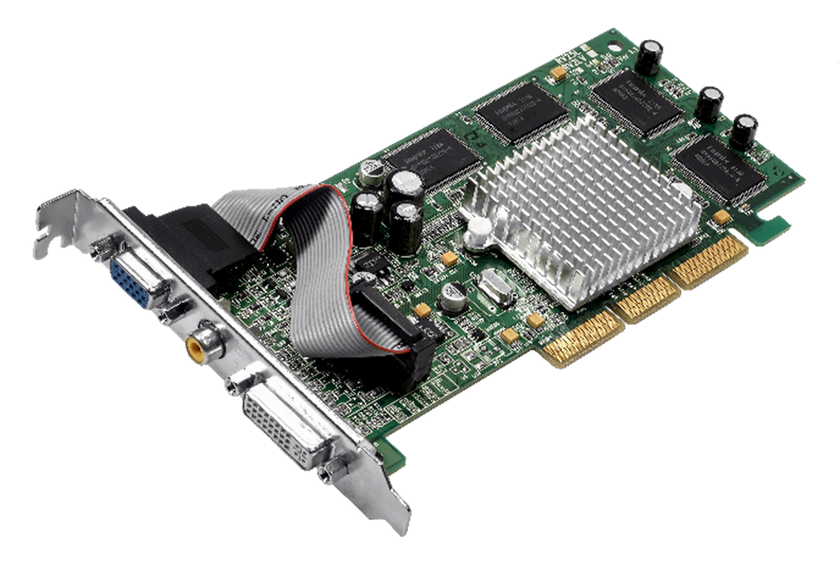
Video Card
Provides video capability
Allows a monitor to connect to PC
VGA
HDMI
DVI
PCIe – PCI Express Slot
VGA
DVI

Slide 17
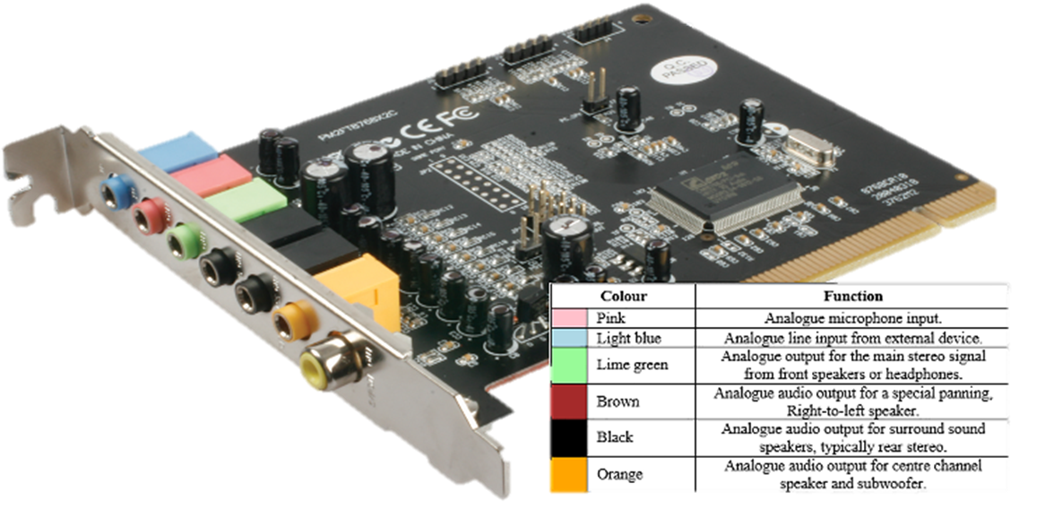
Sound Card
Provides audio capability
Allows speaker systems to connect to computer
3.5mm jack
Sometimes digital SPDIF
PCIe – PCI Express Slot
3.5mm Jacks
SPDIF

Slide 18
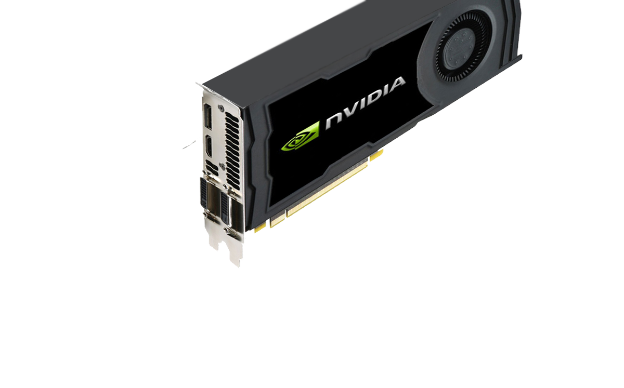
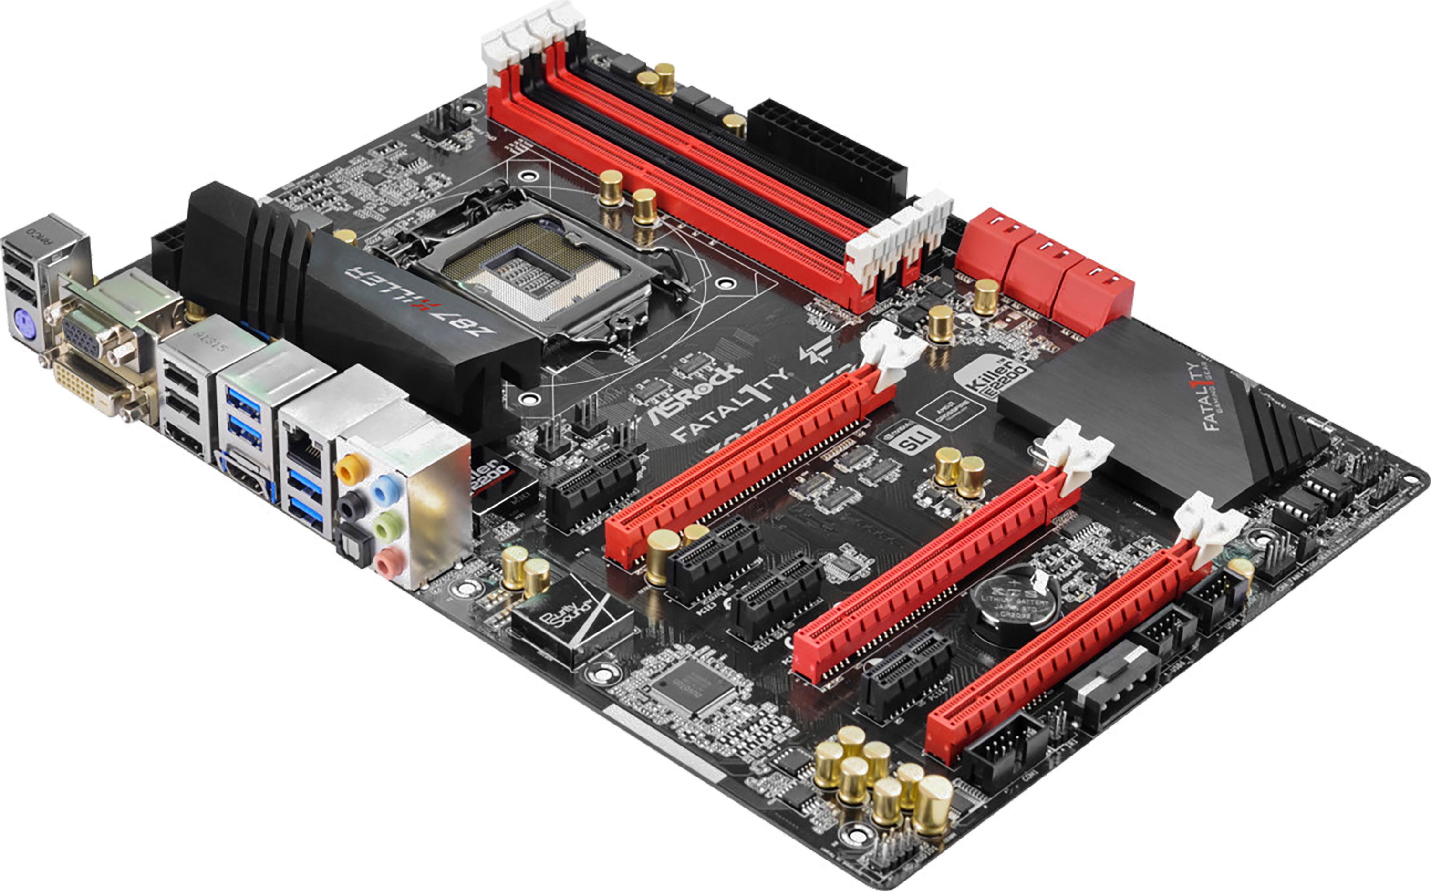

Slide 19
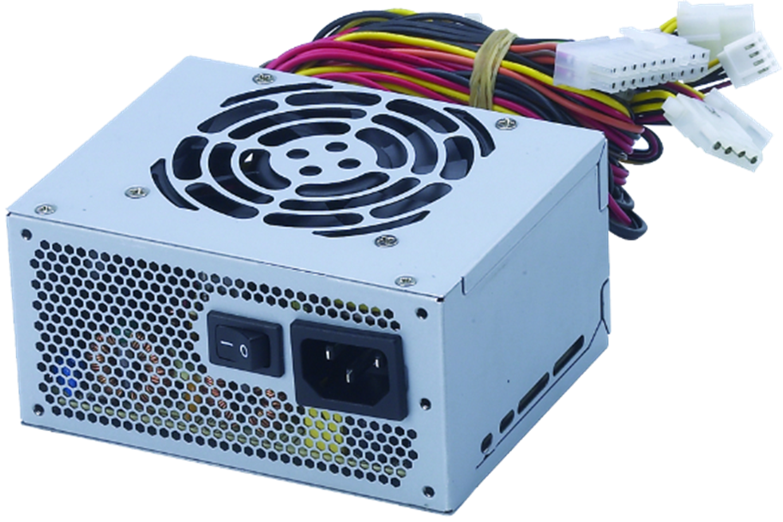
Power Supply
Provides power to motherboard and components
Mains power connects to power supply
Power supply distributes power to internal components
hard drive
motherboard
cards in expansion slots
Some usb devices

Slide 20
BIOS
Basic Input Output System
Perform hardware initialization during the booting process
Loads a boot loader from a mass bootable hard drive which then starts the operating system
New UEFI replaces the old BIOS

Slide 21
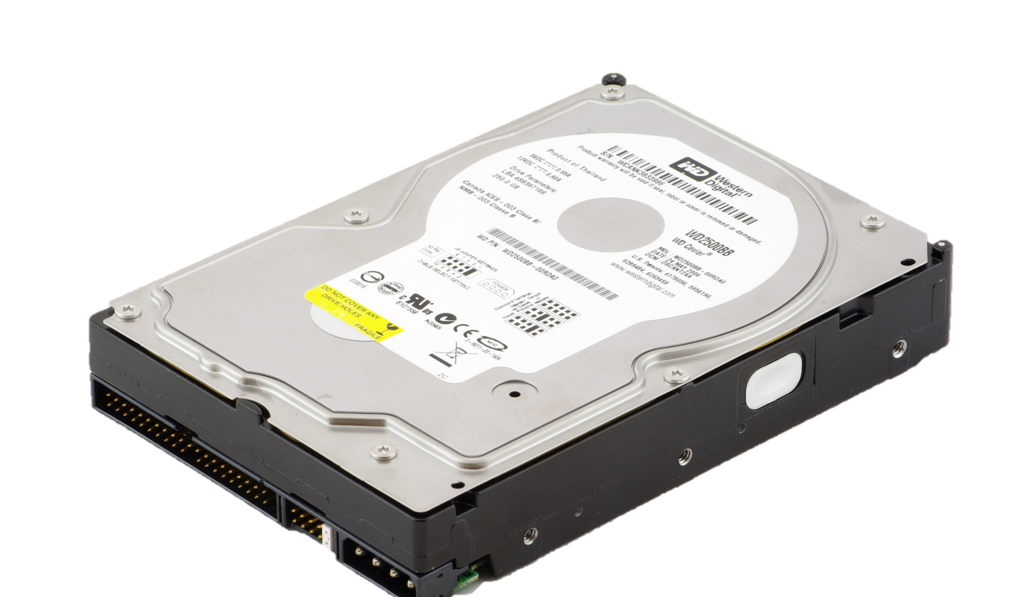
Hard Disk Drive
Also known as secondary storage
Acts like a filing cabinet
Stores files and applications
Connects via SATA or SAS
2.5-inch and 3.5-inch
Components include disk platter, actuator arm and read/write head

Slide 22
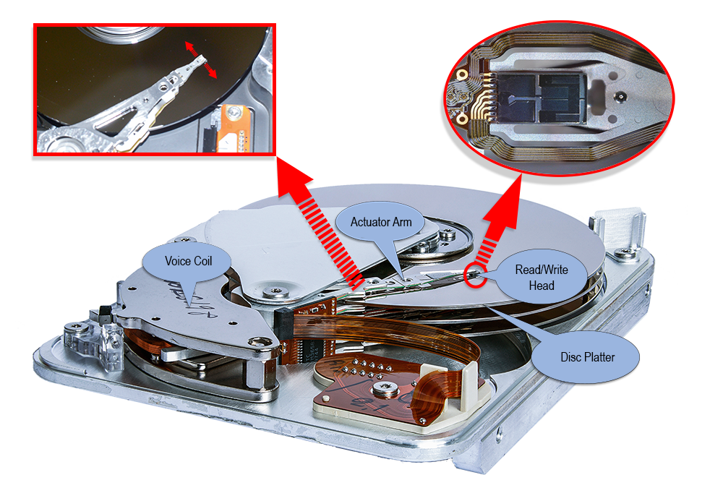

Slide 23
Reading and Writing Data
Surface of the disk is divided into tracks and sectors
Bits of data are arranged into tracks
Tracks are divided into sectors
Each sector stores a fixed amount of data – eg 512 bytes

Slide 24
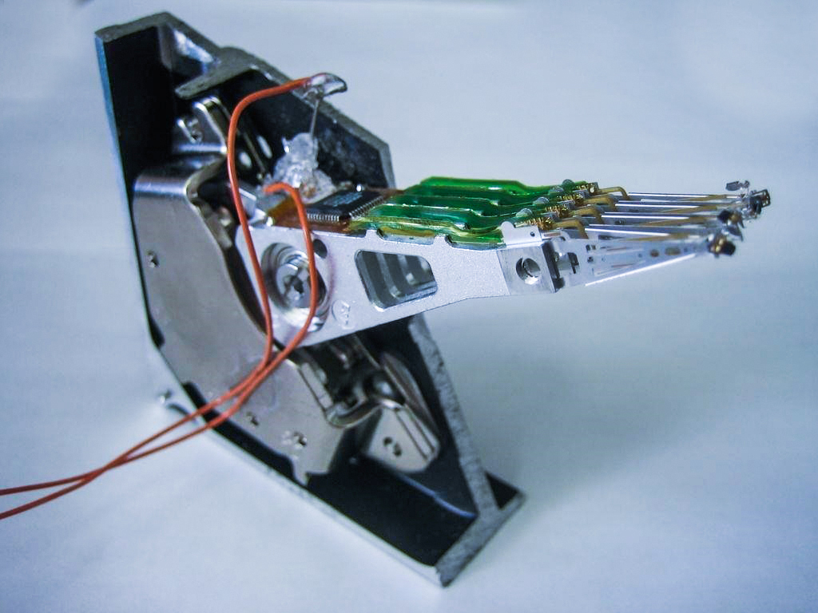

Slide 25
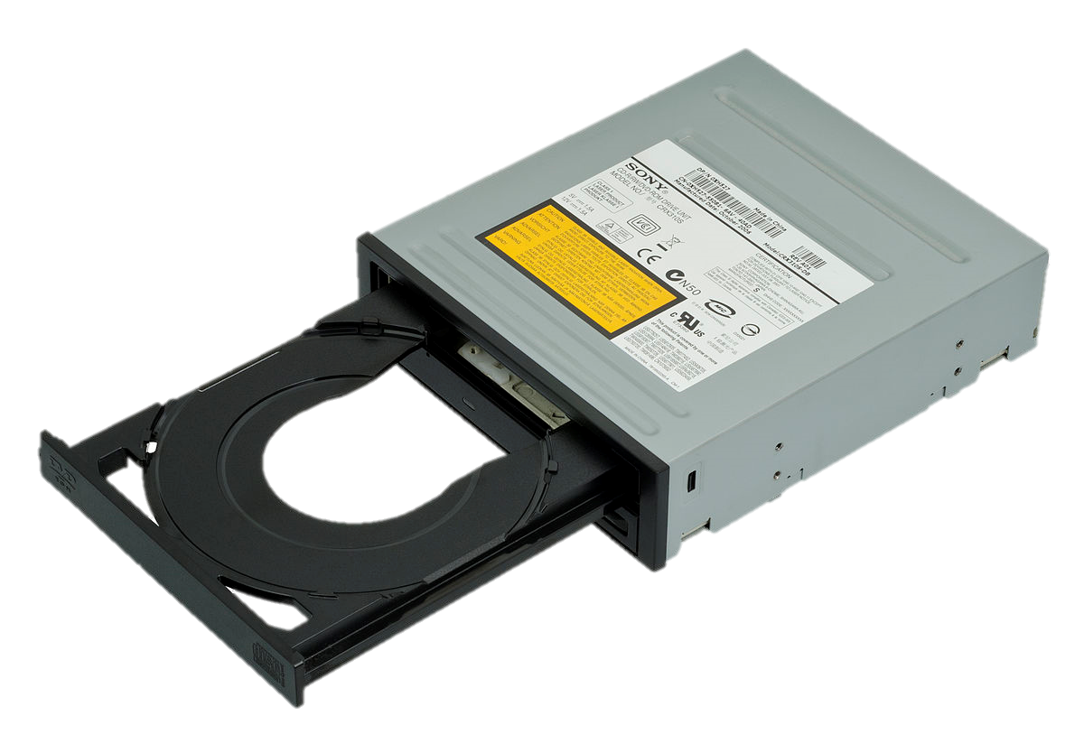
Optical Drive
CD, DVD, Blu-ray
Reads disk with laser
Obsolete nowadays

Slide 26
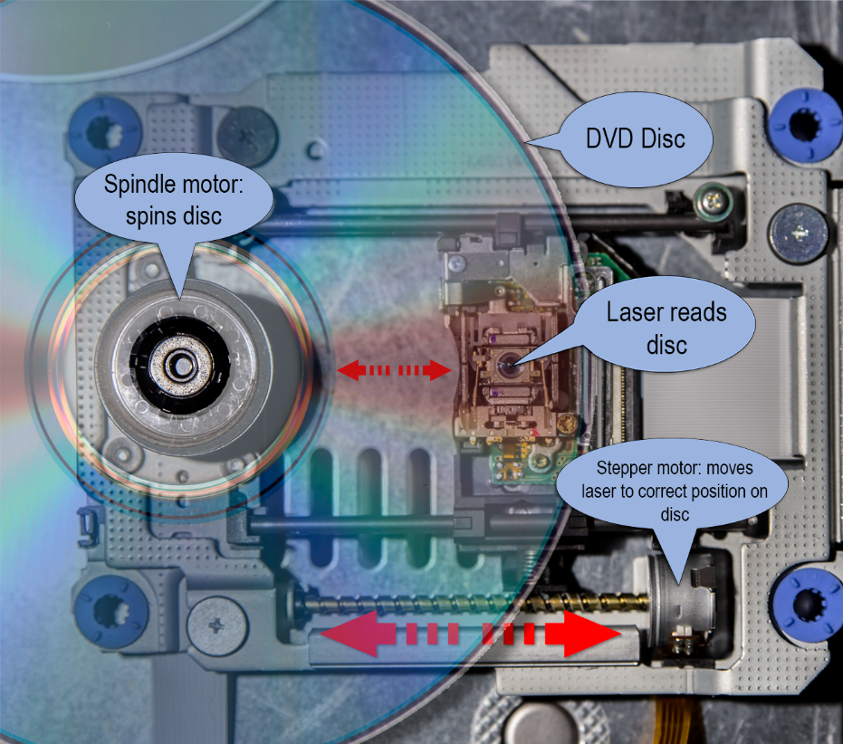

Slide 27
Reading Data
Data is written to the disk in 1 continuous track
Data is encoded in pits and lands
Pit = 0
Land = 1

Slide 28
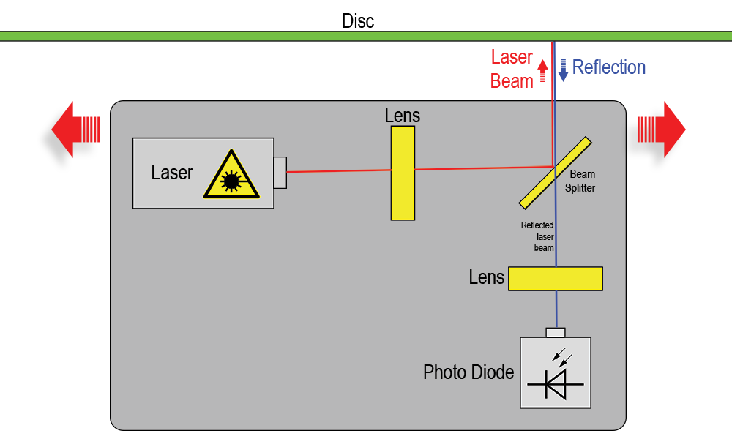

Slide 29
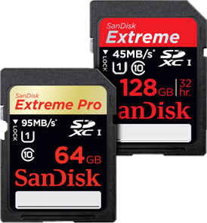
Memory Cards
Various Types
SD
Compact Flash
Can be up to 512GB

Slide 30
External Hard Drives
Portable Hard Disk Drive
Plugs in via USB
Can be up to 1TB or more

Slide 31
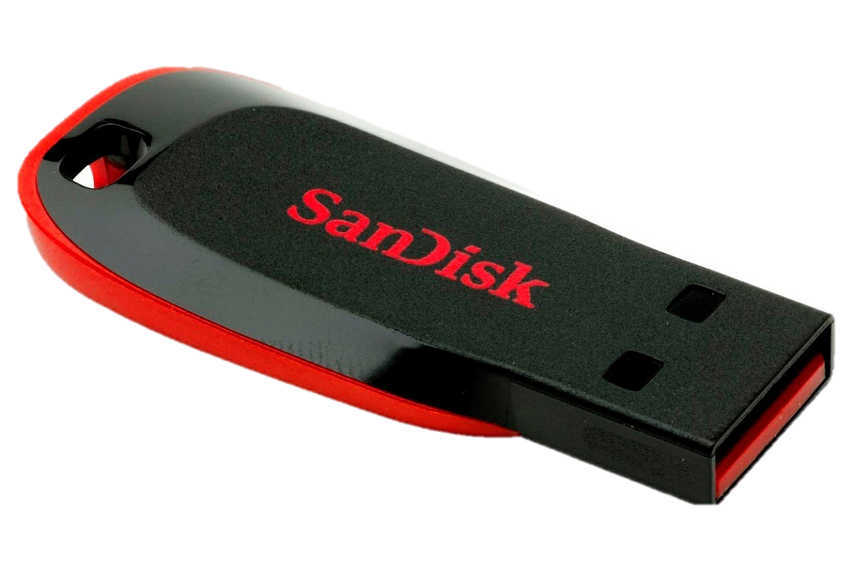
Flash Drives
Stores data on flash memory
Can be up to 512GB, sometimes more
Plugs in via USB

Slide 32
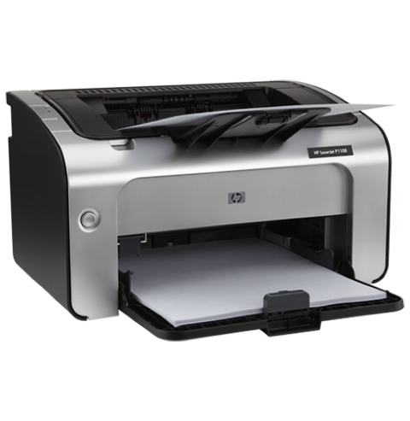
Printers
Laser and Inkjet
Connect to PC via USB or wireless

Slide 33
