Slide 1
Packet Switching
A message is divided up into small units called packets
Packets are made of a header and a payload (ie the actual message data)
The header contains source & destination address and a packet ID
Each packet is sent independently across the network
Packets are received and reassembled at destination and put in order using the Packet ID

Slide 2
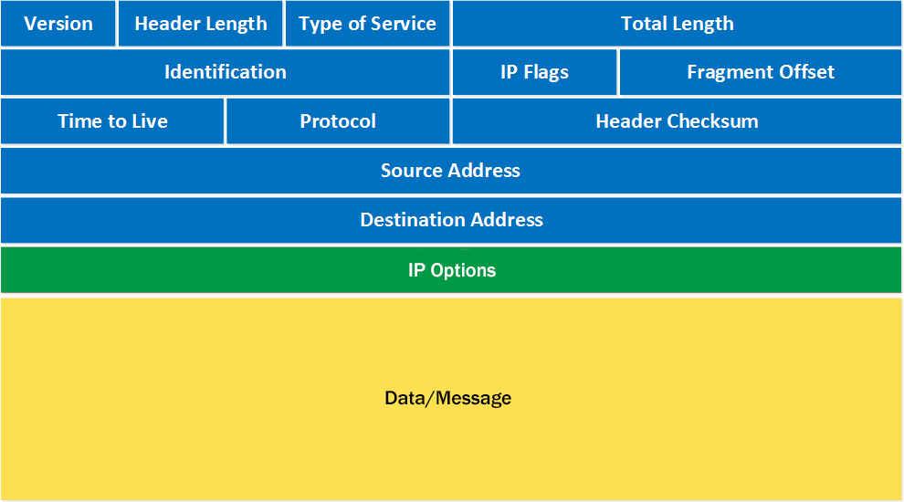

Slide 3
