Slide 1
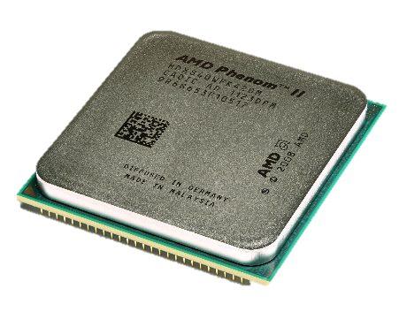
CPU
CPU performs all types of data processing operations
Fetches, decodes and executes instructions stored in RAM
Two lines of chips manufactured by Intel and AMD eg Core i5 and Ryzen 5.

Slide 2
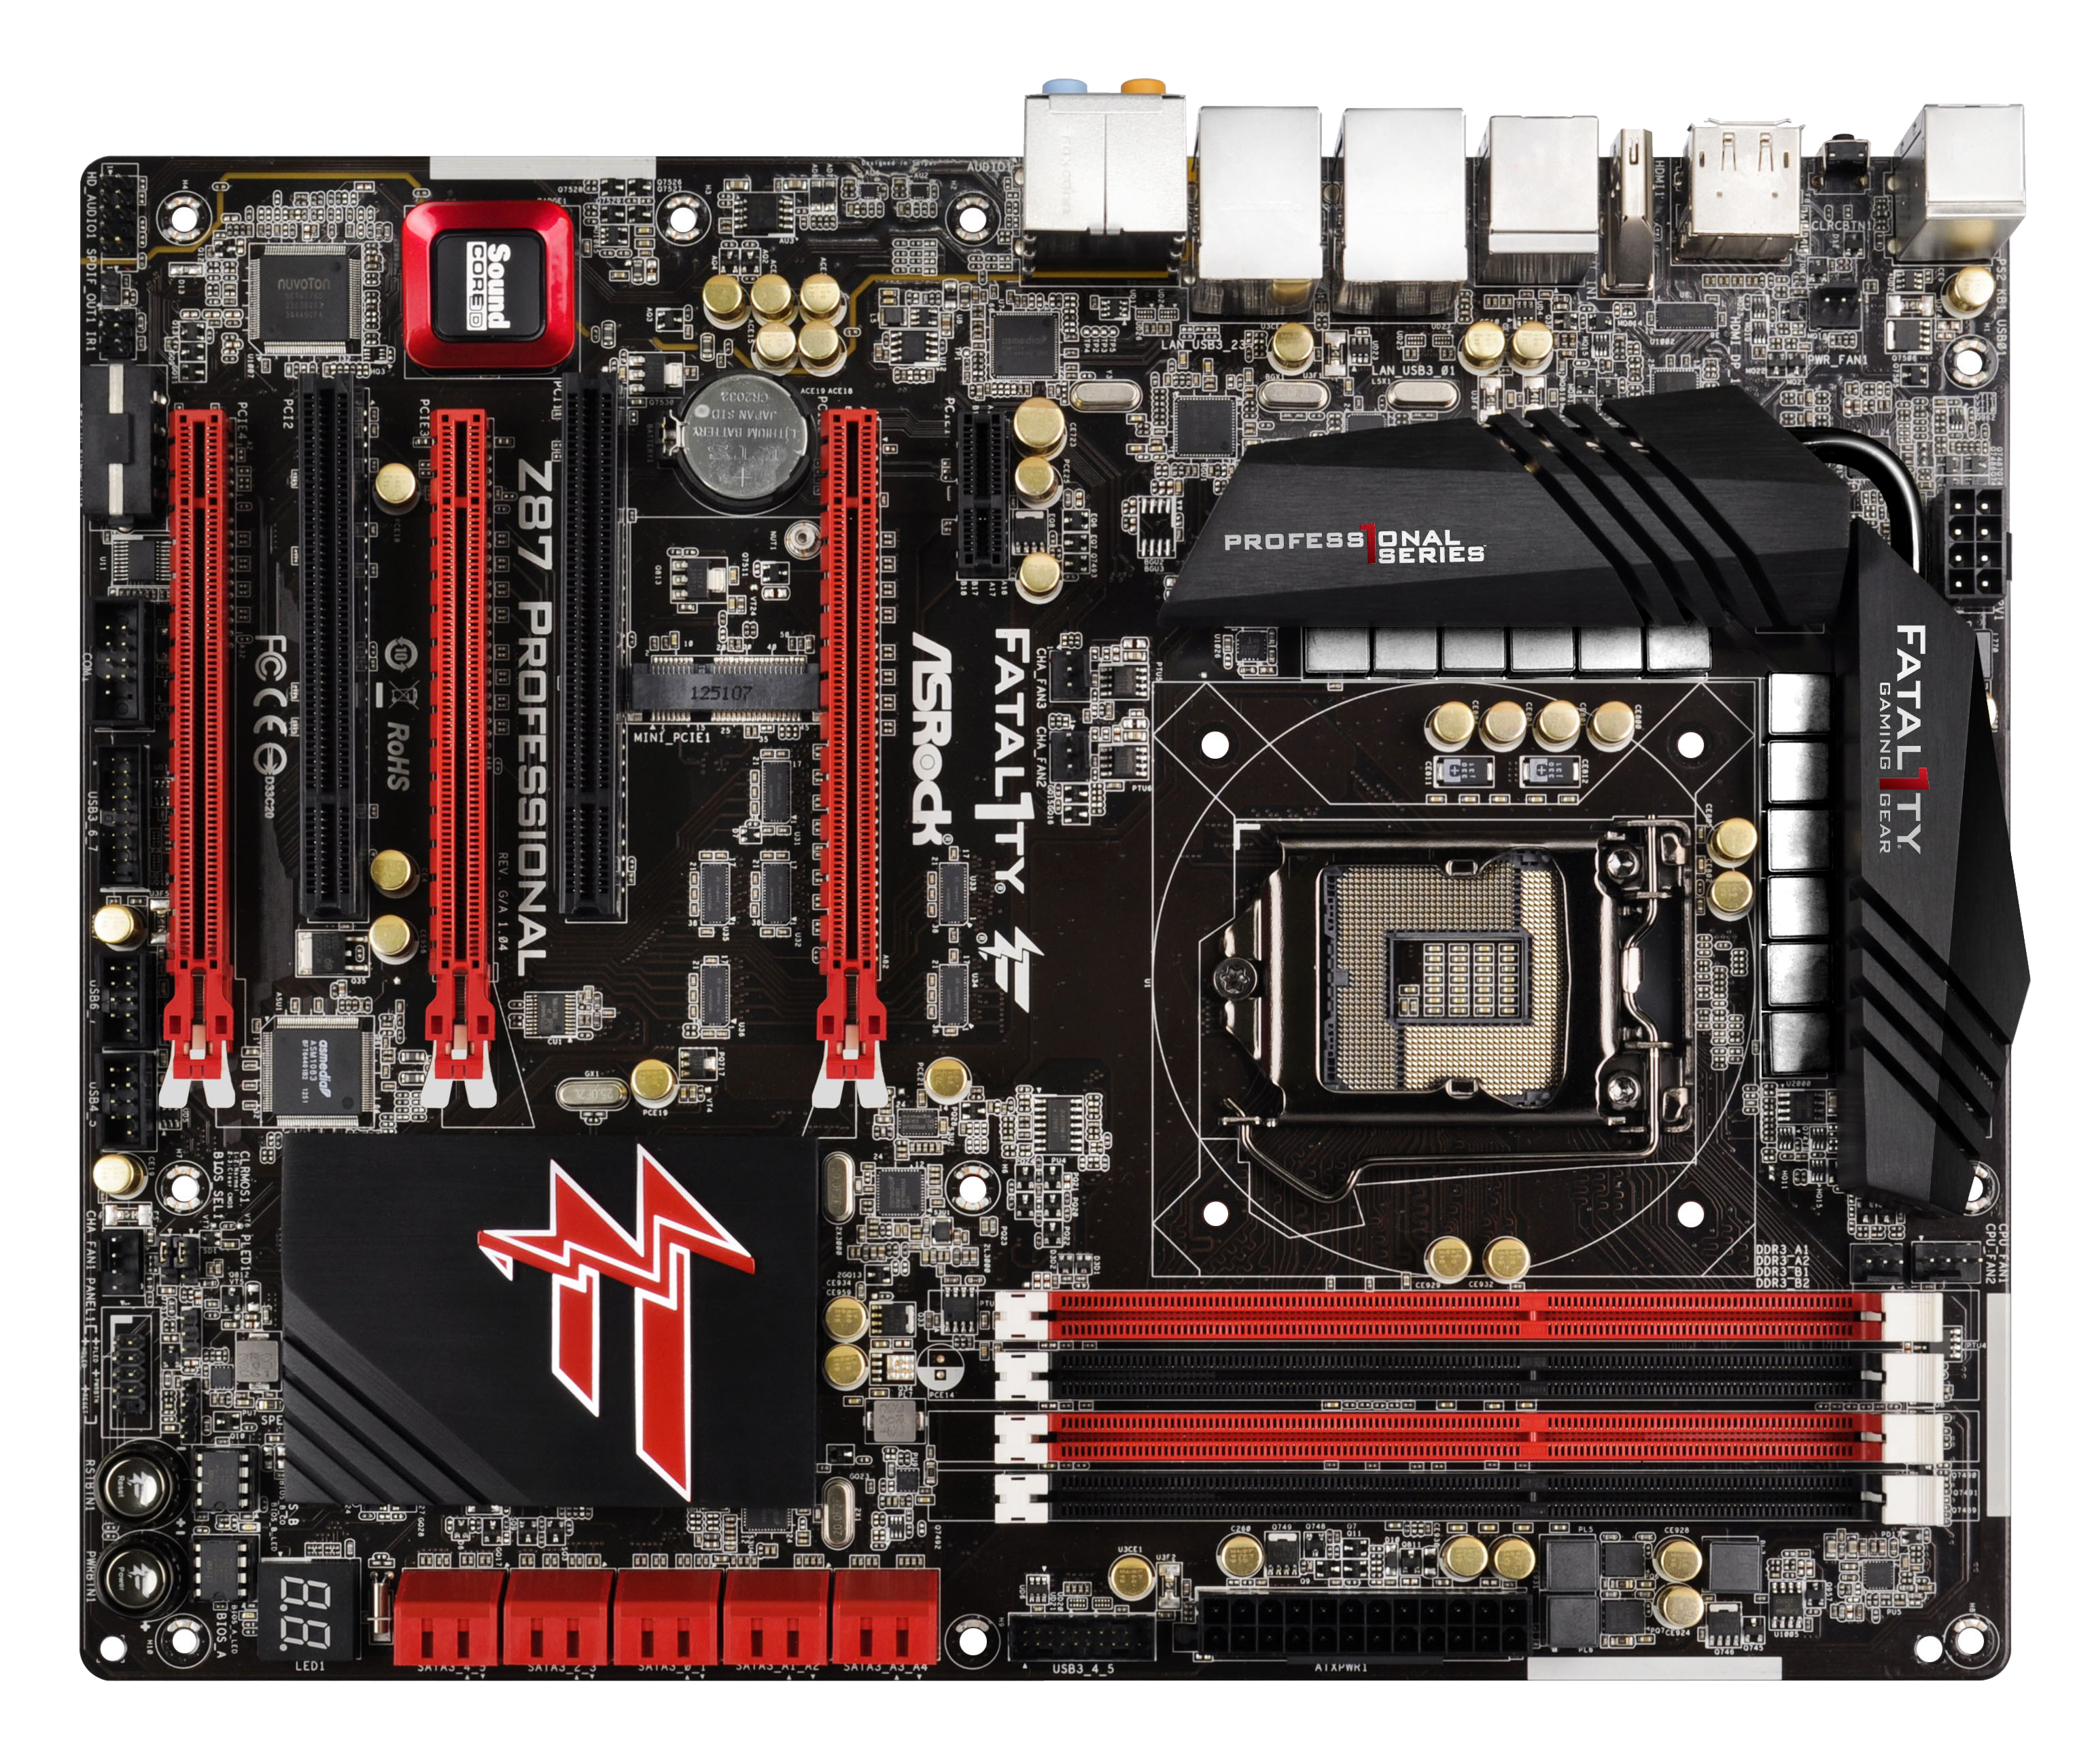

Slide 6
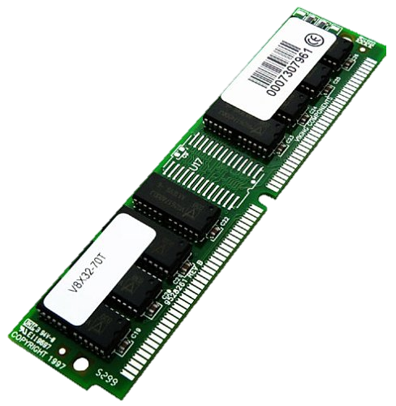
RAM
RAM is volatile, i.e. data stored in is lost when power is off
Two types
SRAM faster, doesn’t need to be refreshed
DRAM slower than SRAM and must be continually refreshed
Comes in SDRAM modules (DDR2, DDR3, DDR4 etc.

Slide 10
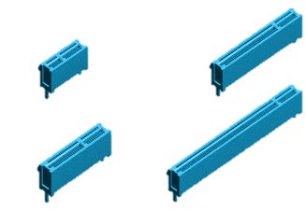
Expansion Slots
A place on the motherboard where expansion cards can be inserted.
PCIe – PCI Express
Various sizes (X1 – X16)
X1 slower for audio/network card
X16 is fast for graphics card
x1
x8
x4
x16

Slide 13
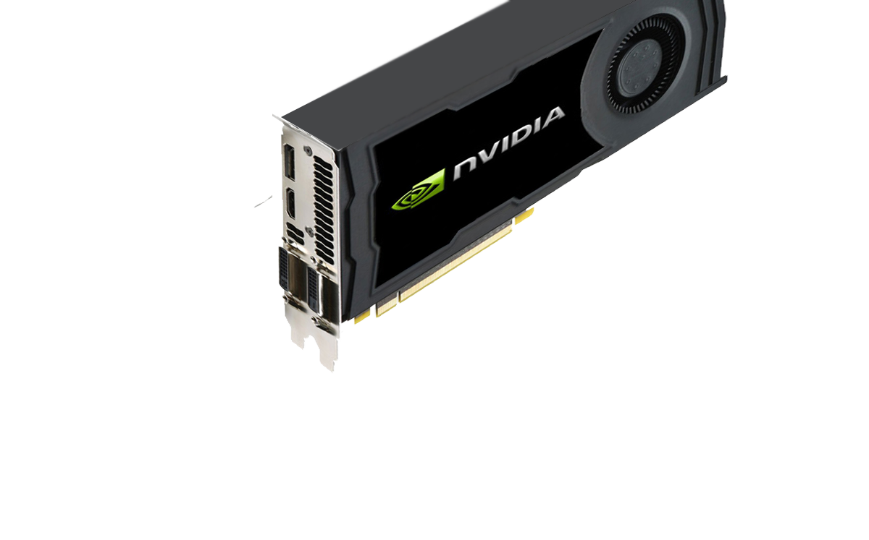
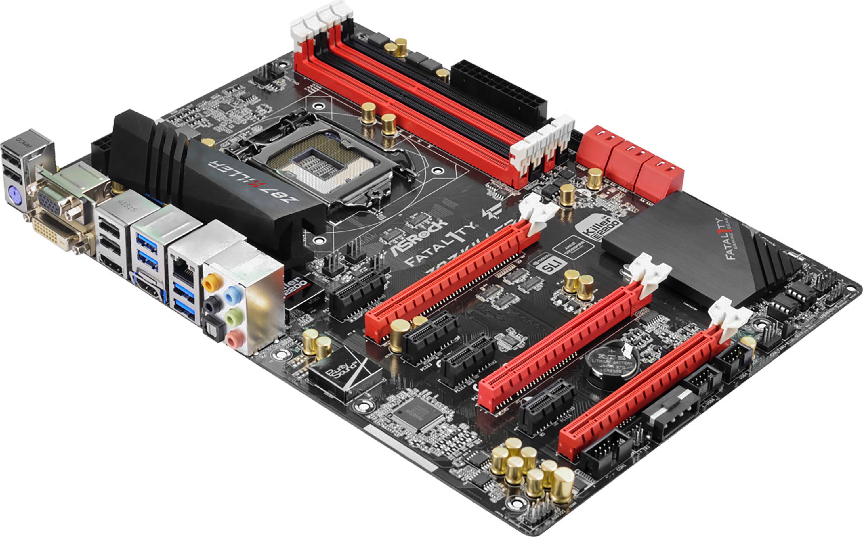

Slide 14
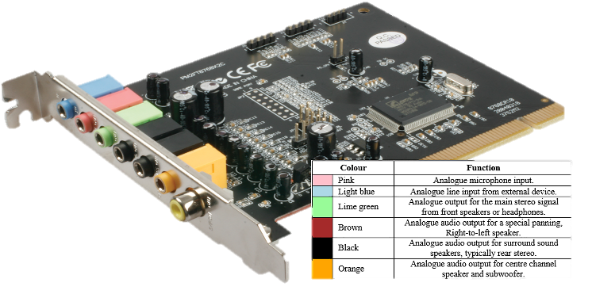
Sound Card
Provides audio capability
Allows speaker systems to connect to computer
3.5mm jack
Sometimes digital SPDIF
PCIe – PCI Express Slot

Slide 15
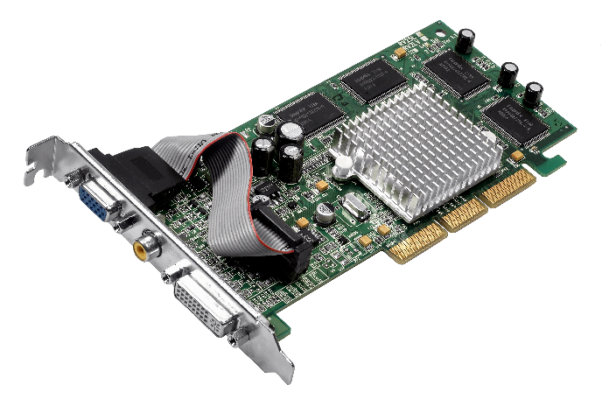
Video Card
Provides video capability
Allows a monitor to connect to PC
VGA
HDMI
DVI
PCIe – PCI Express Slot

Slide 16
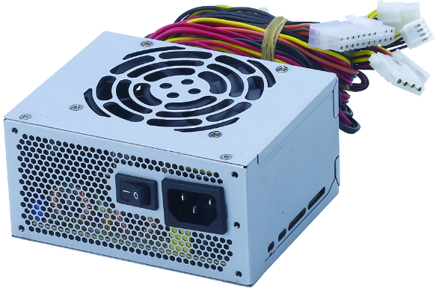
Power Supplies
Provides power to motherboard and components
Mains power connects to power supply
Power supply distributes power to internal components
hard drive
motherboard
cards in expansion slots
Some usb devices

