Slide 1
AND Gate

Slide 2
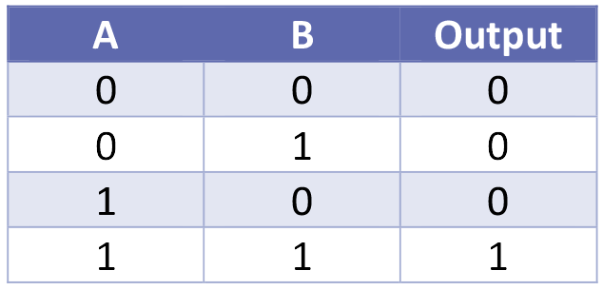
AND Gate

Slide 4
OR Gate

Slide 5
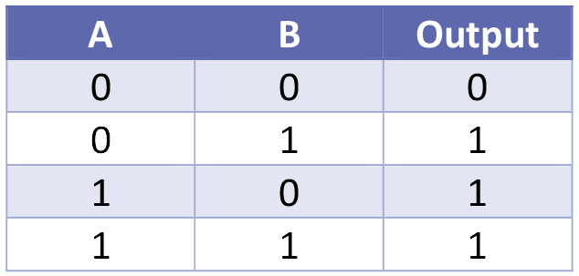
OR Gate

Slide 7
NOT Gate

Slide 8
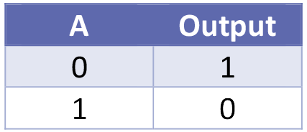
NOT Gate

Slide 9
XOR Gate

Slide 10
XOR Gate

