Slide 1
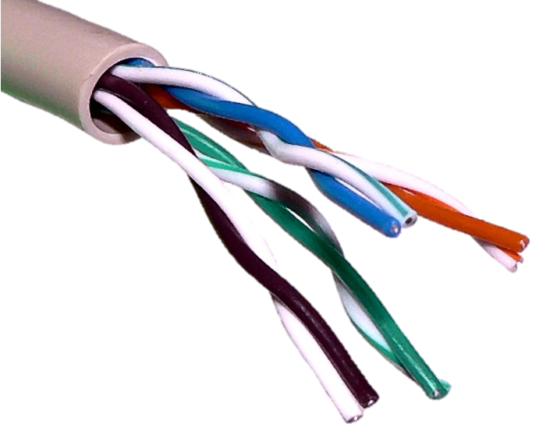
Wide Area Networks
Covers a large geographic area: a country or global
Connects different smaller LANs or MANs together
WANs are implemented either with the public transmission or a private network
Leased Line
ATM
Over internet with a secure tunnel using a virtual private network (VPN).

Slide 2
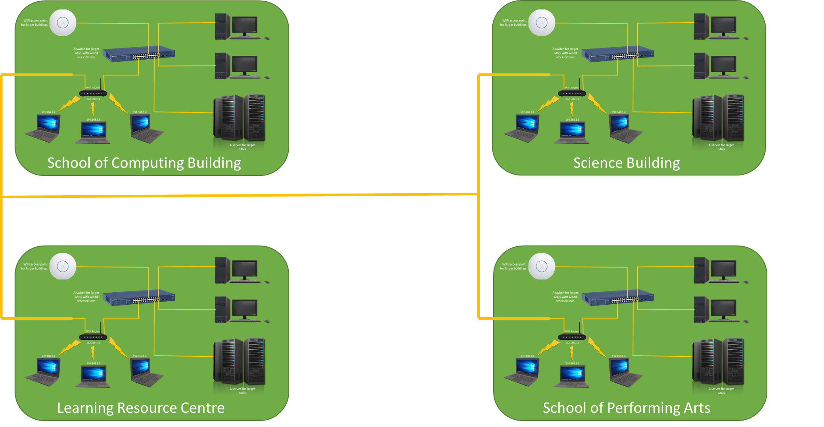

Slide 3
Campus in UK
Campus in USA

