Slide 1
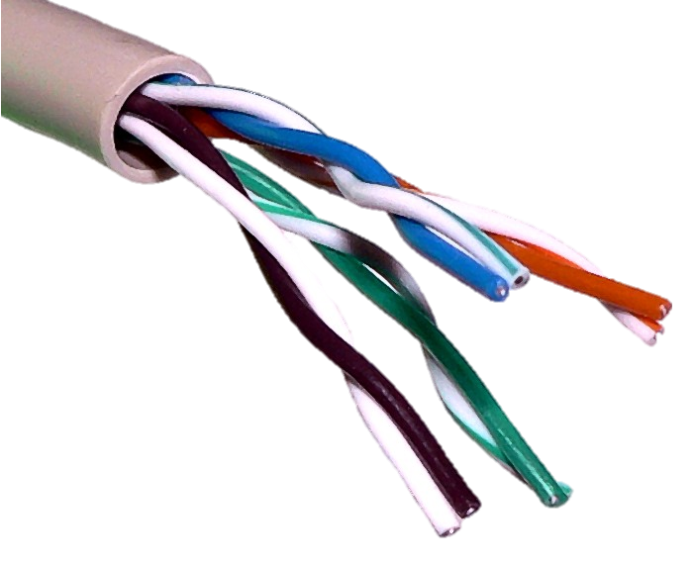
Metropolitan Area Networks
Covers a larger geographic area usually a city
Our university network is a MAN
Each school building in the city is linked together using fibre optic cable

Slide 2
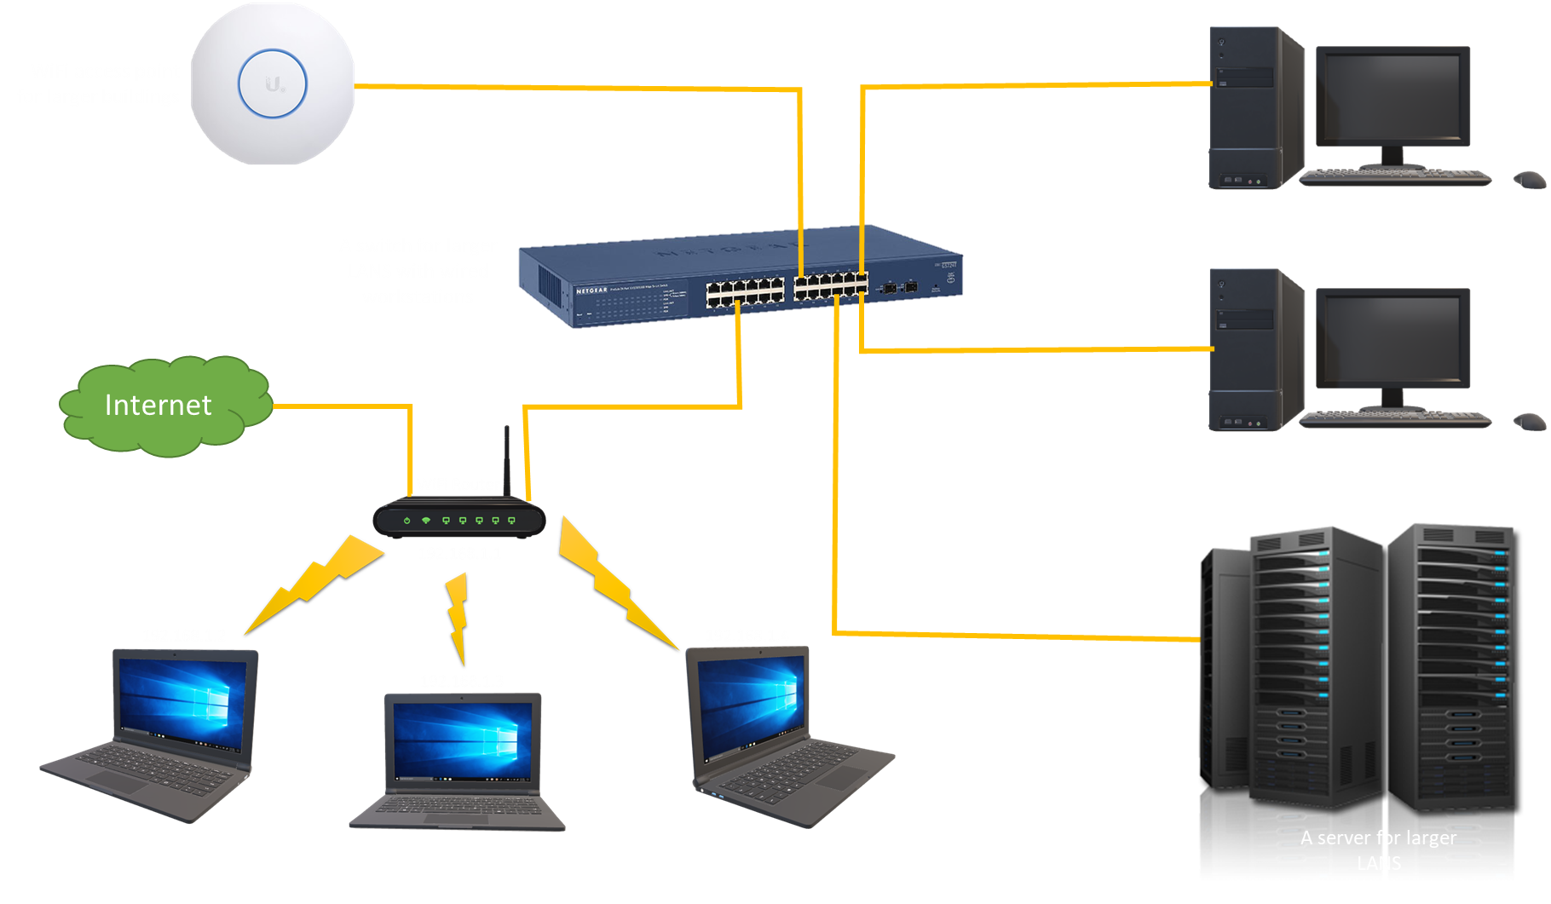

Slide 4
School of Computing Building
Science Building
Learning Resource Centre
School of Performing Arts

Slide 5
LAN 1
LAN 2
School of Computing Building
Science Building
LAN 4
LAN 3
Learning Resource Centre
School of Performing Arts

