Slide 1
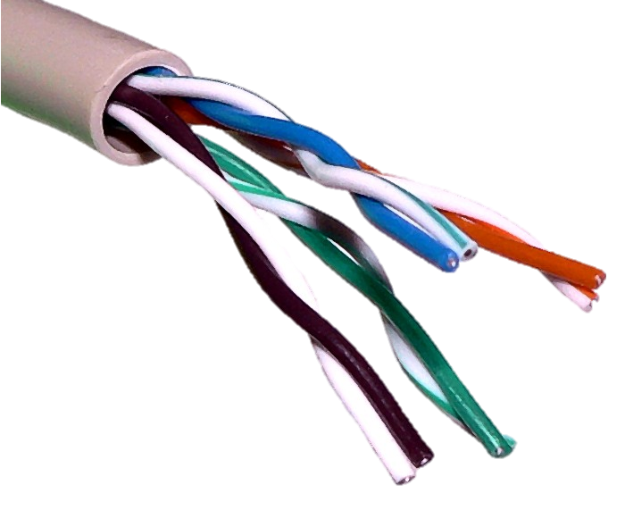
Local Area Networks
Covers a small geographic area such as a home, office, or college building
Devices can be connected via Cat5 cable or WiFi
WiFi is either built into the router such as in a home or by separate access point if in a larger building
802.11g, 802.11n, 802.11ac

Slide 2
WiFi Router
Router: provides internet access, assigns IP addresses to devices
192.168.1.1

Slide 3
WiFi Router
192.168.1.1
Each device that connects, the router assigns an IP address

Slide 4
WiFi Router
192.168.1.1
192.168.1.2
Each device that connects, the router assigns an IP address

Slide 5
WiFi Router
192.168.1.1
192.168.1.2

Slide 6
WiFi Router
192.168.1.1
192.168.1.2
192.168.1.3

Slide 7
WiFi Router
192.168.1.1
192.168.1.2
192.168.1.3

Slide 8
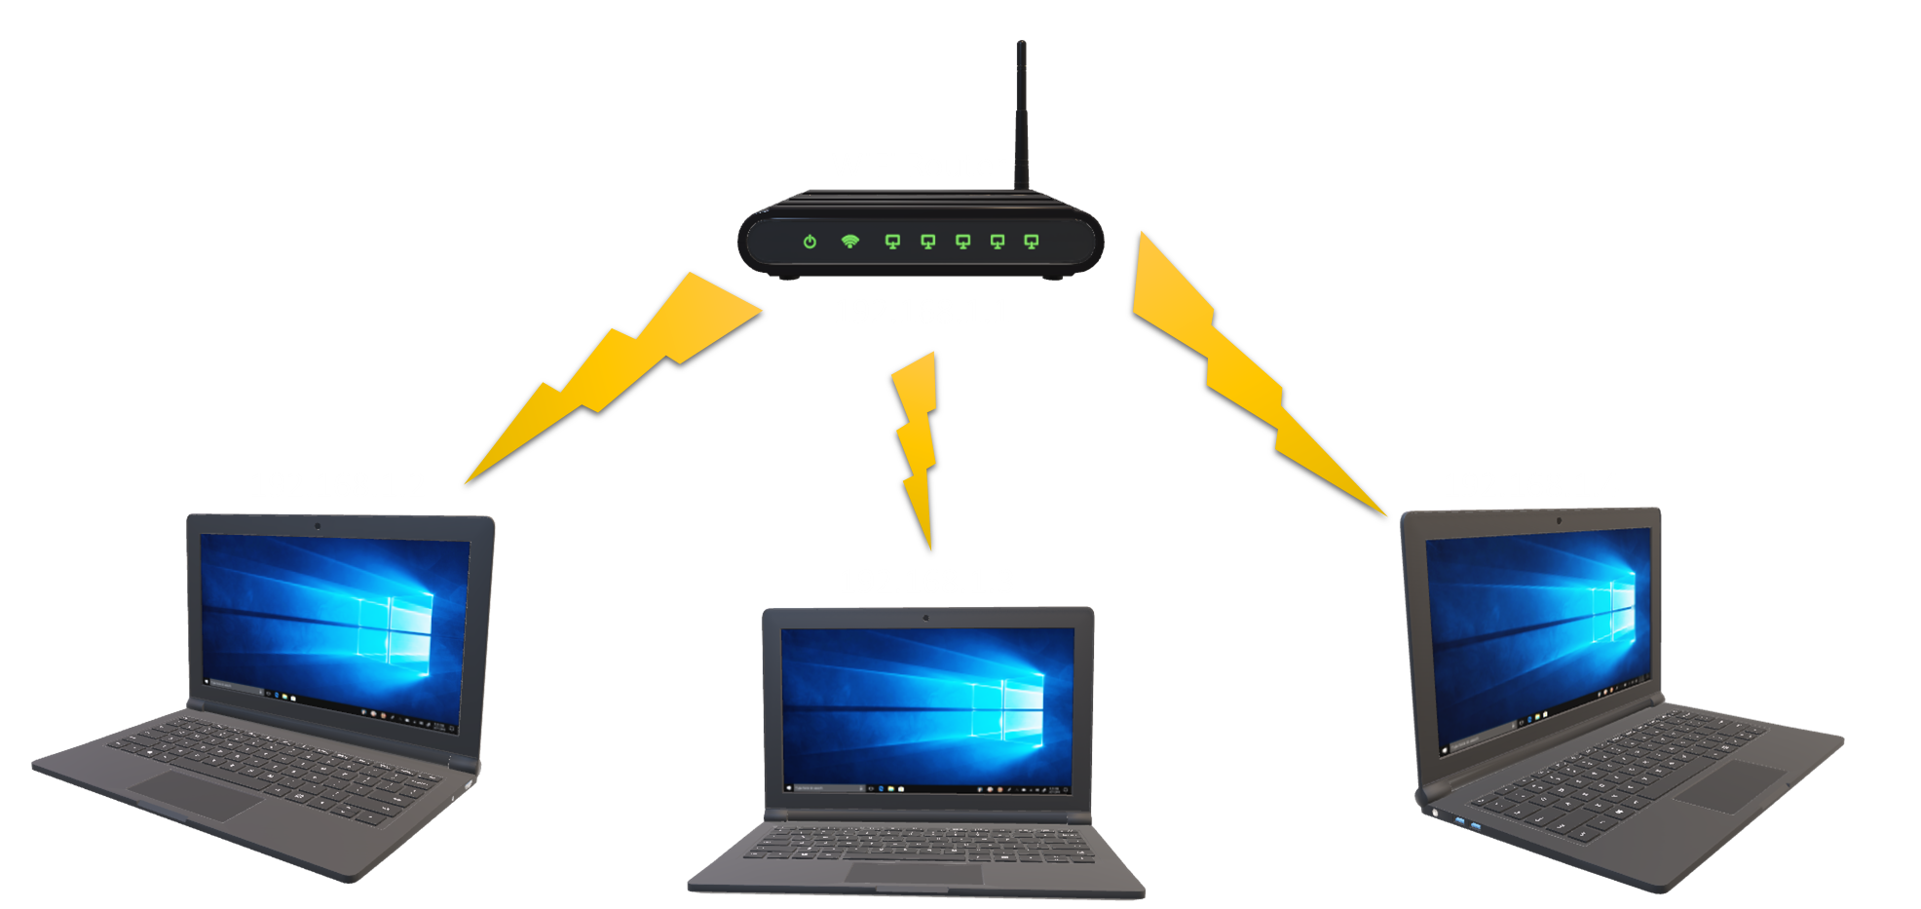

Slide 10
Internet

Slide 11
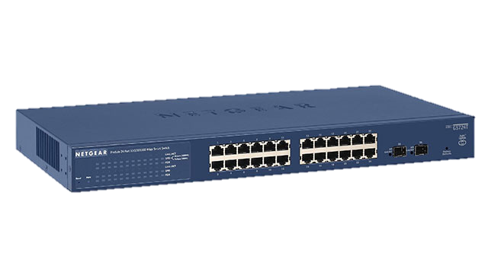
A switch for larger LANS with wired workstations
Internet

Slide 12
A switch for larger LANS with wired workstations
Internet

Slide 13
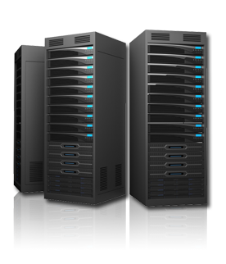
A switch for larger LANS with wired workstations
Internet
A server for larger LANS

Slide 14
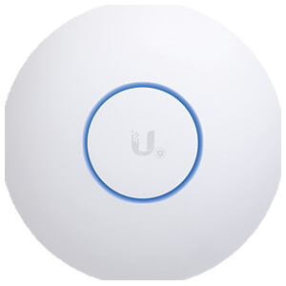
WiFi access point for larger buildings
A switch for larger LANS with wired workstations
Internet
A server for larger LANS

